Slide 1
Sets and Maps
Chapter 9

Slide 2
Chapter Objectives
To understand the C++ set and map containers and how to use them
To learn about hash coding and its use to facilitate efficient search and retrieval
To study two forms of hash tables—open addressing and chaining—and to understand their relative benefits and performance trade-offs

Slide 3
Chapter Objectives (cont.)
To learn how to implement both hash table forms
To be introduced to the implementation of maps and sets
To see how two earlier applications can be implemented more easily using map objects for data storage

Slide 4
Introduction
In Chapter 4 we studied the C++ containers, focusing on the sequential containers vector and list; we studied the deque in chapter 6
Searching for a particular value in a sequential container is generally O(n)
An exception is a binary search for a sorted object, which is O(log n)

Slide 5
Introduction (cont.)
In this chapter, we consider another part of the container framework, the associative containers
Associative containers
are not indexed
do not reveal the order of insertion of items
enable efficient search and retrieval of information
allow removal of elements without moving other elements around

Slide 6
Introduction (cont.)
Associative containers include the set and the map
The set is an implementation of the Set ADT
The map facilitates efficient search and retrieval of entries that consist of pairs of objects
The first object in the pair is the key
The second object is the information associated with that key

Slide 7
Associative Container Requirements
Section 9.1

Slide 8
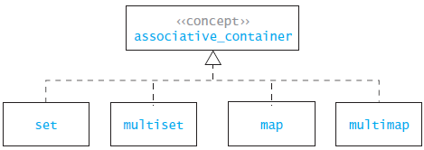
The Set Hierarchy

Slide 9
The set Abstraction
A set is a collection that contains no duplicate elements and at most one null element
adding "apples" to the set {"apples", "oranges", "pineapples"}
results in the same set (i.e. no change)
Operations on sets include:
testing for membership
adding elements
removing elements
union A ∪ B
intersection A ∩ B
difference A – B
subset A ⊂ B

Slide 10
The set Abstraction (cont.)
The union of two sets A, B is a set whose elements belong either to A or B or to both A and B
Example: {1, 3, 5, 7} ∪ {2, 3, 4, 5} is {1, 2, 3, 4, 5, 7}
The intersection of sets A, B is the set whose elements belong to both A and B
Example: {1, 3, 5, 7} ∩ {2, 3, 4, 5} is {3, 5}
The difference of sets A, B is the set whose elements belong to A but not to B
Examples: {1, 3, 5, 7} – {2, 3, 4, 5} is {1, 7}; {2, 3, 4, 5} – {1, 3, 5, 7} is {2, 4}
Set A is a subset of set B if every element of set A is also an element of set B
Example: {1, 3, 5, 7} ⊂ {1, 2, 3, 4, 5, 7} is true

Slide 11
The set Functions
Required methods:
testing set membership (find)
testing for an empty set (empty)
determining set size (size)
creating an iterator over the set (begin, end)
adding an element (insert)
removing an element (erase)
There are no set union, set intersection, or set difference member functions
However, these operators are defined in the algorithm header for all containers, not just sets

Slide 12
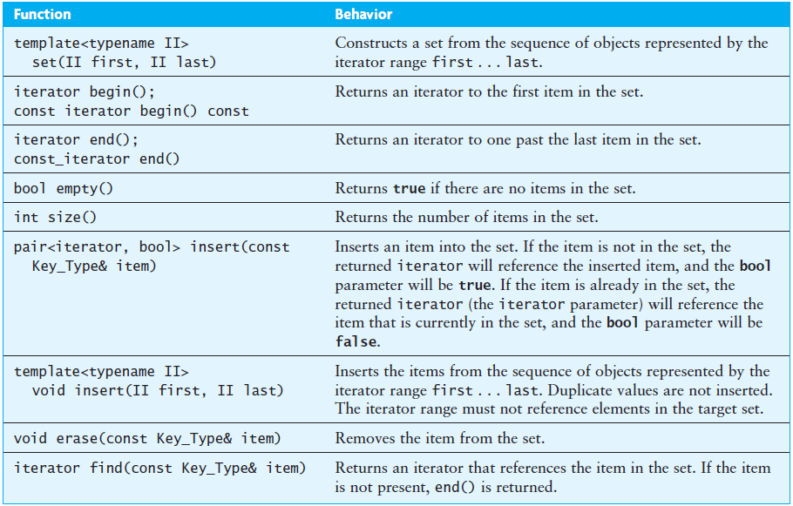
The set Functions (cont.)

Slide 13
The set Functions (cont.)
The set is a template class that takes the following template parameters:
Key_Type: The type of the item contained in the set
Compare: A function class that determines the ordering of the keys; by default this is the less-than operator
Allocator: The memory allocator for key objects; we will use the library supplied default
Although not a requirement, C++ stores items in a set as ordered by their Compare function
If you iterate through a set, you get a sorted list of the contents

Slide 14
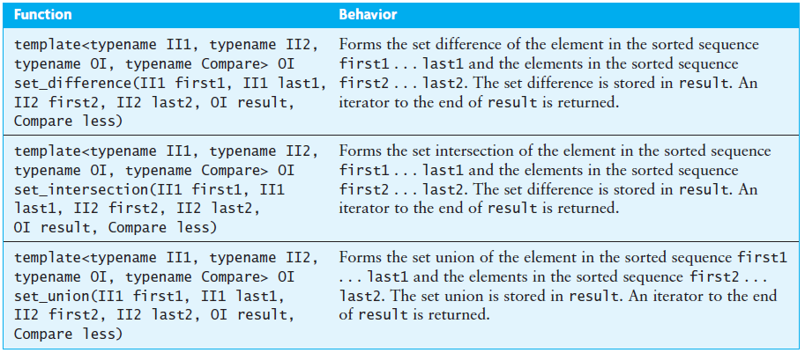
The set Functions (cont.)

Slide 15
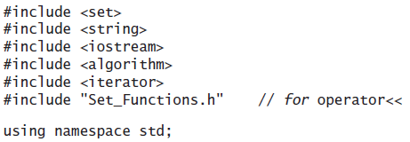
The set Functions (cont.)

Slide 16
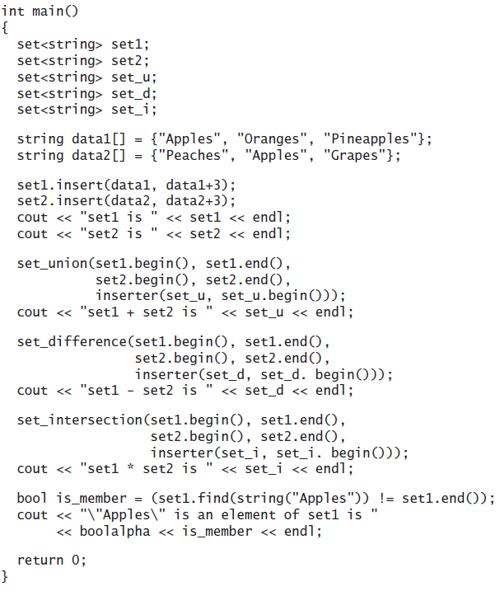
The set Functions (cont.)

Slide 17
The set Functions (cont.)
The iterator adaptor inserter inserts an element into a container rather than overwriting existing elements in the container
It takes two arguments
a container
an iterator within the container
Each insertion appends the next element to the current end of the container

Slide 18
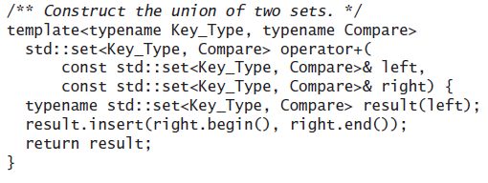
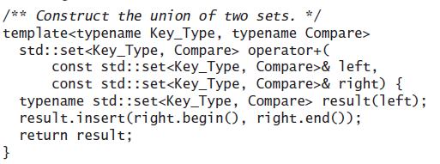
The set Operators +, -, *, and <<
The union operator (+) can be defined as

Slide 19
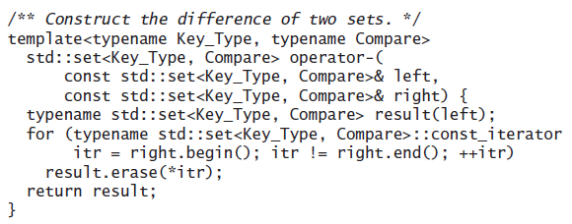
The set Operators +, -, *, and << (cont.)
The difference operator (-) can be defined as

Slide 20
The set Operators +, -, *, and << (cont.)
The membership test can be defined as

Slide 21
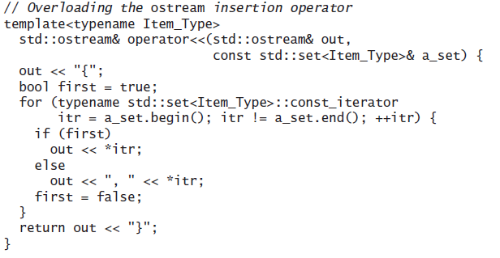
The set Operators +, -, *, and << (cont.)
The ostream insertion operator (<<) can be defined as

Slide 22
Comparison of vectors and sets
vectors and sets both have insert and erase functions, but these functions have different signatures and slightly different meanings
With the vector you must specify the location where the item is to be inserted, but with the set you do not
The set does have an insert function that takes a position argument as a “hint” to speed up the insertion, but the exact position where the item goes is not under the caller’s control
In addition to the iterator referencing the inserted item, the set’s insert function also returns a bool value indicating whether the item was inserted

Slide 23
Comparison of vectors and sets (cont.)
Unlike a vector, a set does not have an subscript operator function (operator[]); therefore, elements cannot be accessed by index
If seta is a set object, the expression seta[0] would cause the following syntax error
no match for 'std::set<int, std::less<int>,
std::allocator<int> >&[int]' operator

Slide 24
Comparison of vectors and sets (cont.)
Although you can’t reference a specific element of a set, you can iterate through all its elements using an iterator object
The iterator itr must be type const_iterator because you can’t change a set’s contents using an iterator
// Create an iterator to seta.
for (set<string>::const_iterator itr = seta.begin();
itr != seta.end(); ++itr) {
string next_item = *itr;
// Do something with next_item
...
}

Slide 25
The multiset
The multiset is the same as the set except that it does not impose the requirement that the items be unique
The insert function always inserts a new item, and duplicate items are retained
However, the erase function removes all occurrences of the specified item because there may be duplicates

Slide 26
The multiset (cont.)
The functions lower_bound and upper_bound can be used to select the group of entries that match a desired value
If the item is present, both functions return iterators
lower_bound returns an iterator to the first occurrence of the specified value
upper_bound returns an iterator to the smallest item that is larger than the specified value
The desired entries are between the iterators returned by these two functions
If the item is not present, both upper_bound and lower_bound return an iterator to the smallest element that is larger than the specified entry

Slide 27
The multiset (cont.)
The following function determines the number of occurrences of the string target in the multiset<string> words_set
int count_occurrences(const multiset<string>& words_set,
const string& target) {
multiset<string>::const_iterator first_itr =
words_set.lower_bound(target);
multiset<string>::const_iterator last_itr =
words_set.upper_bound(target);
int count = 0;
for (multiset<string>::const_iterator itr = first_itr;
itr != last_itr; ++itr)
++count;
return count;
}

Slide 28
The multiset (cont.)
These functions are also defined for the set
They can be used to define a subset by setting a pair of iterators to two values within the set
For example, if the set fruits is {"Apples", "Grapes", "Oranges", "Peaches", "Pears", "Pineapples", "Tomatoes"}, then
lower_bound("Peaches")
would return an iterator to "Peaches", and
upper_bound("Pineapples")
would return an iterator to "Tomatoes".
These two iterators would define the subset of fruits between "Peaches" and "Pineapples"

Slide 29
Standard Library Class pair
The C++ standard library defines the class pair in the header <utility>
This class is a simple grouping of two values typically of different types
The members are named first and second
Pairs are used as the return type from functions that need to return two values, such as the set::insert function, and as the element type for maps
Since all of its members are public, it is declared as a struct

Slide 30
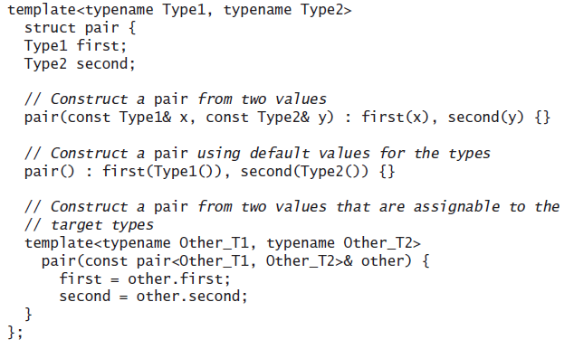
Standard Library Class pair (cont.)

Slide 31
Standard Library Class pair (cont.)
A template function is defined to create a pair object from two arguments

Slide 32
Standard Library Class pair (cont.)
The less-than operator is defined for class pair

Slide 33
Maps and Multimaps
Section 9.2

Slide 34
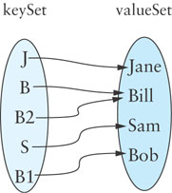
Maps and Multimaps
The map is related to the set
Mathematically, a map is a set of ordered pairs whose elements are known as the key and the value
Keys must be unique, but values need not be unique
You can think of each key as a “mapping” to a particular value
A map provides efficient storage and retrieval of information in a table
A map can have many-to-one mapping: (B, Bill), (B2, Bill)
{(J, Jane), (B, Bill), (S, Sam), (B1, Bob), (B2, Bill)}

Slide 35
Maps and Multimaps (cont.)
In an onto mapping, all the elements of values have a corresponding member in keys
A map can be used to enable efficient storage and retrieval of information in a table
The key is a unique identification value associated with each item stored in a table
The “value” in the key/value pair might be an object, or even a pointer to an object, with objects in the class distinguished by some attribute associated with the key that is then mapped to the value

Slide 36
Maps and Multimaps (cont.)
When information about an item is stored in a table, the information should have a unique ID
A unique ID may or may not be a number
This unique ID is equivalent to a key
Type of item | Key | Value
University student | Student ID number | Student name, address, major, grade point average
Online store customer | E-mail address | Customer name, address, credit card information, shopping cart
Inventory item | Part ID | Description, quantity, manufacturer, cost, price

Slide 37
Maps and Multimaps (cont.)
In comparing maps to indexed collections, you can think of the keys as selecting the elements of a map, just as indexes select elements in a vector object
The keys for a map, however, can have arbitrary values (not restricted to 0, 1, 2, and so on, as for indexes)
The subscript operator is overloaded for the map class, so you can have statements of the form:
v = a_map[k]; // Assign to v the value for key k
a_map[k] = v1; // Set the value for key k to v1
where k is of the key type, v and v1 are of the value type, and a_map is a map.

Slide 38
The map Functions
A map is effectively defined as a set whose items are pairs
The member functions defined for both are the same except for the type of the parameters
The map is a template class that takes the following template parameters:
Key_Type: The type of the keys contained in the key set
Value_Type: The type of the values in the value set
Compare: A function class that determines the ordering of the keys; by default this is the less-than operator
Allocator: The memory allocator for key objects; we will use the library-supplied default

Slide 39
The map Functions (cont.)
Items are stored in a map, ordered by their Compare function
If you iterate through a map, you get a sorted list of the contents
The Compare function is used to create the function class Key_Compare, which compares only the Key_Type part of the pair<const Key_Type, Value_Type> items (called Entry_Type) that are stored in a map
(The key for an entry can’t be changed, but the value can be)

Slide 40
The map Functions (cont.)
struct Key_Compare {
bool operator()(const Entry_Type& left,
const Entry_Type& right) const {
return left.first < right.first;
}
};

Slide 41
The map Functions (cont.)
The map functions are all implemented by delegation to the corresponding set functions
In addition to the set functions, the map class overloads the subscript operator such that the key is used as an index (for example, a_map[k])
For this reason, a map is also known as an associative array

Slide 42
The map Functions (cont.)
The code that overloads the subscript operator is placed at the end of the public part of the class definition and begins as follows:
Value_Type& operator[](const Key_Type& key) {
std::pair<iterator, bool> ret
= the_set.insert(Entry_Type(key, Value_Type()));
This statement inserts in the_set a pair consisting of the key and a dummy value.

Slide 43
The map Functions (cont.)
Because changing a value that is in a set could disrupt the ordering of the items, the set::iterator’s dereferencing operators always return a const reference to the object referenced
We need to return a non-const reference to the Value_Type part of the Entry_Type object
Thus we need to use a const_cast to remove the const qualification
Entry_Type& entry(const_cast<Entry_Type&>(*(ret.first)));

Slide 44
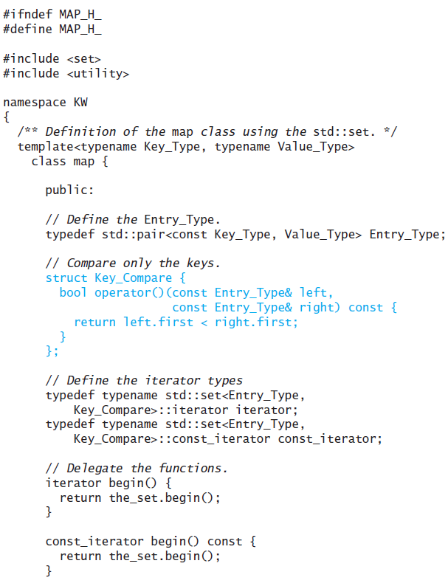
The map Functions (cont.)

Slide 45
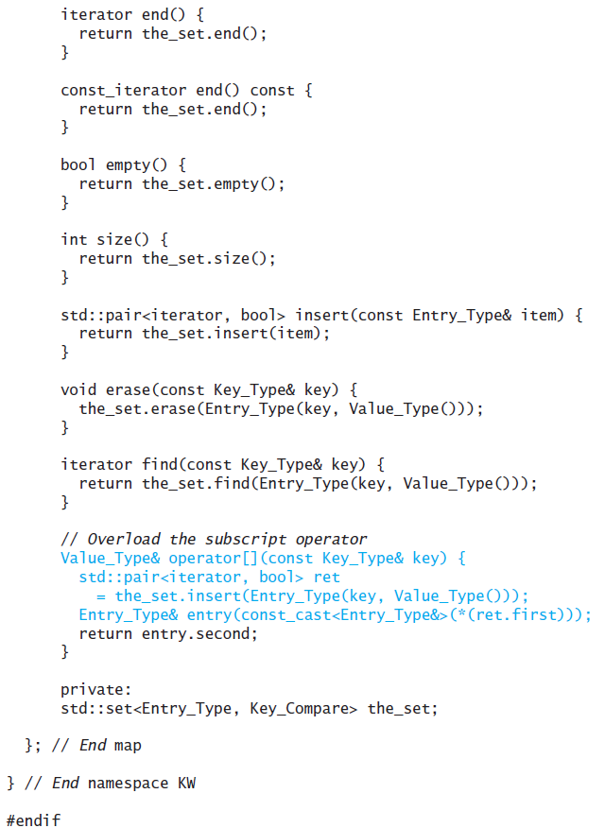
The map Functions (cont.)

Slide 46
The map Functions (cont.)
The following statements build a map object:
map<string, string> a_map;
a_map["J"] = "Jane";
a_map["B"] = "Bill";
a_map["S"] = "Sam";
a_map["B1"] = "Bob";
a_map["B2"] = "Bill";
J
Jane
B
Bill
S
Sam
B1
Bob
B2

Slide 47
The map Functions (cont.)
cout << "B1 maps to " << a_map["B1"] << endl;
displays:
B1 maps to Bob
J
Jane
B
Bill
S
Sam
B1
Bob
B2

Slide 48
Map Interface (cont.)
cout << "Bill maps to " << a_map["Bill"] << endl;
displays:
Bill maps to
(a side effect of this statement is that "Bill" would now be a key in the map associated with the empty string)
J
Jane
B
Bill
S
Sam
B1
Bob
B2

Slide 49
Creating an Index of Words
In Section 8.4 we used a binary search tree to store an index of words occurring in a term paper
Each element in the binary search tree consisted of a word followed by a three digit line number
If we store the index in a map, we can store all the line number occurrences for a word in a single index entry

Slide 50
Creating an Index of Words (cont.)
Each time a word is encountered, its list of line numbers is retrieved (using the word as key)
The most recent line number is appended to this list

Slide 51
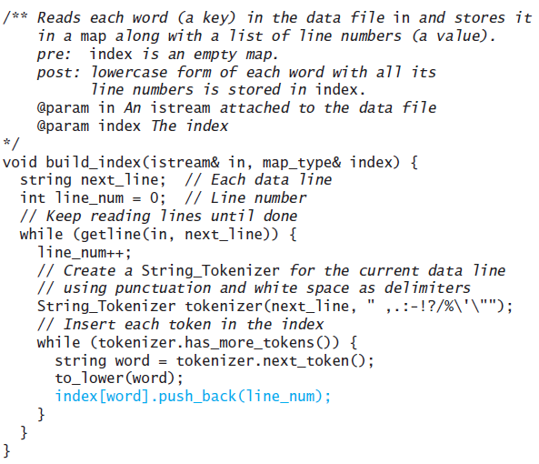
Creating an Index of Words (cont.)

Slide 52
Defining the Compare Function
Assume that we want to use the class Person, with data fields family_name and given_name to be the key in a map; the family_name should determine the ordering of Person objects
However, if two Person objects have the same family_name, then we need to use the given_name
struct Compare_Person {
bool operator()(const Person& p1, const Person& p2) {
if (p1.family_name < p2.family_name)
return true;
else
return (p1.family_name == p2.family_name)
&& (p1.given_name < p2.given_name);
}
}

Slide 53
The multimap
Like the multiset, the multimap removes the restriction that the keys are unique
The subscript operator is not defined for the multimap
Instead, lower_bound and upper_bound must be used to obtain a range of iterators that references the values mapped to a given key

Slide 54
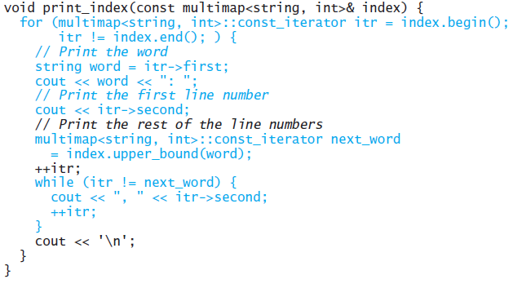
The multimap (cont.)

Slide 55
Hash Tables
Section 9.3

Slide 56
Hash Tables
The C++ standard library uses a special type of binary search tree, called a balanced binary search tree, to implement the set and map classes
This provides access to items in O(log n) time.
Sets and maps can also be implemented using a data structure known as a hash table, which has some advantages over balanced search trees

Slide 57
Hash Tables (cont.)
The goal of hash table is to be able to access an entry based on its key value, not its location
We want to be able to access an entry directly through its key value, rather than by having to determine its location first by searching for the key value in an array
Using a hash table enables us to retrieve an entry in constant time (on average, O(1))

Slide 58
Hash Codes and Index Calculation
The basis of hashing is to transform the item’s key value into an integer value (its hash code) which is then transformed into a table index

Slide 59
Hash Codes and Index Calculation (cont.)
Consider the Huffman code problem from the last chapter
If a text contains only ASCII values, which are the first 128 Unicode values, we could use a table of size 128 and let its Unicode value be its location in the table
int index = ascii_char
ascii_char represents the character we are seeking in the table

Slide 60
Hash Codes and Index Calculation (cont.)
. . . | . . .
65 | A, 8
66 | B, 2
67 | C, 3
68 | D, 4
69 | E, 12
70 | F, 2
71 | G, 2
72 | H, 6
73 | I, 7
74 | J, 1
75 | K, 2
. . . | . . .
However, what if all 65,536 Unicode characters were allowed?
If you assume that on average 100 characters were used, you could use a table of 200 characters and compute the index by:
int index = uni_char % 200

Slide 61
Hash Codes and Index Calculation (cont.)
If a text contains this snippet:
. . . mañana (tomorrow), I'll finish my program. . .
Given the following Unicode values:
The indices for letters 'ñ' and ')' are both 41
41 % 200 = 41 and 241 % 200 = 41
This is called a collision; we will discuss how to deal with collisions shortly
Hexadecimal | Decimal | Name | Character
0x0029 | 41 | right parenthesis | )
0x00F1 | 241 | small letter n with tilde | ñ

Slide 62
Functions for Generating Hash Codes
In most applications, a key will consist of strings of letters or digits (such as a Social Security Number, an email address, or a partial ID) rather than a single character
The number of possible key values is much larger than the table size
Generating good hash codes typically is an experimental process
The goal is a random distribution of values
Simple algorithms sometimes generate lots of collisions

Slide 63
Functions for Generating Hash Codes (cont.)
For strings, simply summing the char values of all characters returns the same hash code for "sign" and "sing"
One algorithm that has shown good results uses the following formula:
s₀ x 31^{(n-1)} + s₁ x 31^{(n-2)} + … + s_{n-1}
where s_{i} is the ith character of the string, and n is the length of the string
“Cat” has a hash code of:
‘C’ x 31² + ‘a’ x 31 + ‘t’ = 67,510
31 is a prime number, and prime numbers generate relatively few collisions

Slide 64
Functions for Generating Hash Codes (cont.)
Because there are too many possible strings, the integer value returned by the function can't be unique
However, the probability of two strings having the same hash code value is relatively small, because this function distributes the hash code values fairly evenly throughout the range of int values

Slide 65
Functions for Generating Hash Codes (cont.)
Because the hash codes are distributed evenly throughout the range of int values, this function appears to produce a random value that can be used as the table index for retrieval
If the object is not already present in the table, the probability that the table slot with this index is empty is proportional to how full the table is

Slide 66
Functions for Generating Hash Codes (cont.)
Although the hash function result appears to be random and gives a random distribution of keys, keep in mind that the calculation is deterministic
You always get the same hash code for a particular key
A good hash function should be relatively simple and efficient to compute
It doesn't make sense to use an O(n) hash function to avoid doing an O(n) search

Slide 67
Open Addressing
We now consider two ways to organize hash tables:
open addressing
chaining
In open addressing, linear probing can be used to access an item (type Entry_Type*) in a hash table
If the index calculated for an item's key is occupied by an item with that key, we have found the item
If that element contains an item with a different key, increment the index by one
Keep incrementing until you find the key or a NULL entry (assuming the table is not full)

Slide 68
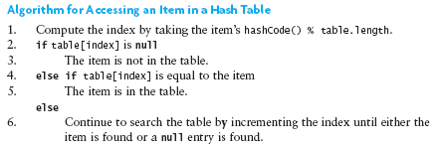
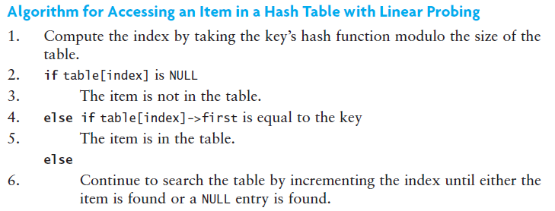
Open Addressing (cont.)

Slide 69
Table Wraparound and Search Termination
As you increment the table index, your table should wrap around as in a circular array
This enables you to search the part of the table before the hash code value in addition to the part of the table after the hash code value
But this could lead to an infinite loop
How do you know when to stop searching if the table is full and you have not found the correct value?
Stop when the index value for the next probe is the same as the hash code value for the object
Or ensure that the table is never full by increasing its size after an insertion when its load factor exceeds a specified threshold

Slide 70
Hash Code Insertion Example
Tom
Dick
Harry
Sam
Pete
Name | hash_fcn() | hash_fcn()%5
"Tom" | 84274 | 4
"Dick" | 2129869 | 4
"Harry" | 69496448 | 3
"Sam" | 82879 | 4
"Pete" | 2484038 | 3
[0]
[1]
[2]
[3]
[4]
Tom

Slide 71
Hash Code Insertion Example (cont.)
Dick
Harry
Sam
Pete
Name | hash_fcn() | hash_fcn()%5
"Tom" | 84274 | 4
"Dick" | 2129869 | 4
"Harry" | 69496448 | 3
"Sam" | 82879 | 4
"Pete" | 2484038 | 3
[0]
[1]
[2]
[3]
Dick
[4]
Tom

Slide 72
Hash Code Insertion Example (cont.)
Harry
Sam
Pete
Name | hash_fcn() | hash_fcn()%5
"Tom" | 84274 | 4
"Dick" | 2129869 | 4
"Harry" | 69496448 | 3
"Sam" | 82879 | 4
"Pete" | 2484038 | 3
[0]
Dick
[1]
[2]
[3]
Dick
[4]
Tom

Slide 73
Hash Code Insertion Example (cont.)
Harry
Sam
Pete
Name | hash_fcn() | hash_fcn()%5
"Tom" | 84274 | 4
"Dick" | 2129869 | 4
"Harry" | 69496448 | 3
"Sam" | 82879 | 4
"Pete" | 2484038 | 3
[0]
Dick
[1]
[2]
[3]
Harry
[4]
Tom

Slide 74
Hash Code Insertion Example (cont.)
Sam
Pete
Name | hash_fcn() | hash_fcn()%5
"Tom" | 84274 | 4
"Dick" | 2129869 | 4
"Harry" | 69496448 | 3
"Sam" | 82879 | 4
"Pete" | 2484038 | 3
[0]
Dick
[1]
[2]
[3]
Harry
Sam
[4]
Tom

Slide 75
Hash Code Insertion Example (cont.)
Pete
Name | hash_fcn() | hash_fcn()%5
"Tom" | 84274 | 4
"Dick" | 2129869 | 4
"Harry" | 69496448 | 3
"Sam" | 82879 | 4
"Pete" | 2484038 | 3
Sam
[0]
Dick
[1]
[2]
[3]
Harry
Sam
[4]
Tom

Slide 76
Hash Code Insertion Example (cont.)
Pete
Name | hash_fcn() | hash_fcn()%5
"Tom" | 84274 | 4
"Dick" | 2129869 | 4
"Harry" | 69496448 | 3
"Sam" | 82879 | 4
"Pete" | 2484038 | 3
Sam
[0]
Dick
[1]
Sam
[2]
[3]
Harry
[4]
Tom

Slide 77
Hash Code Insertion Example (cont.)
Pete
Name | hash_fcn() | hash_fcn()%5
"Tom" | 84274 | 4
"Dick" | 2129869 | 4
"Harry" | 69496448 | 3
"Sam" | 82879 | 4
"Pete" | 2484038 | 3
[0]
Dick
[1]
Sam
[2]
Pete
[3]
Harry
[4]
Tom

Slide 78
Hash Code Insertion Example (cont.)
Name | hash_fcn() | hash_fcn()%5
"Tom" | 84274 | 4
"Dick" | 2129869 | 4
"Harry" | 69496448 | 3
"Sam" | 82879 | 4
"Pete" | 2484038 | 3
[0]
Dick
[1]
Sam
[2]
[3]
Harry
Pete
[4]
Tom

Slide 79
Hash Code Insertion Example (cont.)
Name | hash_fcn() | hash_fcn()%5
"Tom" | 84274 | 4
"Dick" | 2129869 | 4
"Harry" | 69496448 | 3
"Sam" | 82879 | 4
"Pete" | 2484038 | 3
Pete
[0]
Dick
[1]
Sam
[2]
[3]
Harry
[4]
Tom

Slide 80
Hash Code Insertion Example (cont.)
Name | hash_fcn() | hash_fcn()%5
"Tom" | 84274 | 4
"Dick" | 2129869 | 4
"Harry" | 69496448 | 3
"Sam" | 82879 | 4
"Pete" | 2484038 | 3
[0]
Dick
Pete
[1]
Sam
[2]
[3]
Harry
[4]
Tom

Slide 81
Hash Code Insertion Example (cont.)
Name | hash_fcn() | hash_fcn()%5
"Tom" | 84274 | 4
"Dick" | 2129869 | 4
"Harry" | 69496448 | 3
"Sam" | 82879 | 4
"Pete" | 2484038 | 3
[0]
Dick
Pete
[1]
Sam
[2]
Pete
[3]
Harry
[4]
Tom
Retrieval of "Tom" or "Harry" takes one step, O(1)
Because of collisions, retrieval of the others requires a linear search

Slide 82
Hash Code Insertion Example (cont.)
Name | hash_fcn() | hash_fcn()%11
"Tom" | 84274 | 3
"Dick" | 2129869 | 5
"Harry" | 69496448 | 10
"Sam" | 82879 | 5
"Pete" | 2484038 | 7
[0]
[1]
[2]
[3]
[4]
[5]
[6]
[7]
[8]
[9]
[10]

Slide 83
Hash Code Insertion Example (cont.)
Name | hash_fcn() | hash_fcn()%11
"Tom" | 84274 | 3
"Dick" | 2129869 | 5
"Harry" | 69496448 | 10
"Sam" | 82879 | 5
"Pete" | 2484038 | 7
[0]
[1]
[2]
[3]
Tom
[4]
Only one collision occurred
[5]
Dick
[6]
Sam
[7]
Pete
[8]
The best way to reduce the possibility of collision (and reduce linear search retrieval time because of collisions) is to increase the table size
[9]
[10]
Harry

Slide 84
Traversing a Hash Table
You cannot traverse a hash table in a meaningful way since the sequence of stored values is arbitrary
[0]
[0]
Dick
[1]
[1]
Sam
[2]
Tom, Dick, Sam, Pete, Harry
[2]
Pete
[3]
Tom
[3]
Harry
[4]
[4]
Tom
[5]
Dick
[6]
Sam
Dick, Sam, Pete, Harry, Tom
[7]
Pete
[8]
[9]
[10]
Harry

Slide 85
Deleting an Item Using Open Addressing
When an item is deleted, you cannot simply set its table entry to null
If we search for an item that may have collided with the deleted item, we may conclude incorrectly that it is not in the table
Instead, store a dummy value or mark the location as available, but previously occupied
Deleted items reduce search efficiency which is partially mitigated if they are marked as available
You cannot replace a deleted item with a new item until you verify that the new item is not in the table

Slide 86
Reducing Collisions by Expanding the Table Size
To reduce collisions, use a prime number for the size of the table
A fuller table results in more collisions, so, when a hash table becomes sufficiently full, a larger table should be allocated and the entries reinserted
You must reinsert (rehash) values into the new table; do not simply transfer values as some search chains which were wrapped may break
Deleted items are not reinserted, which saves space and reduces the length of some search chains

Slide 87
Reducing Collisions by Expanding the Table Size (cont.)
Algorithm for Rehashing
1. Allocate a new hash table with twice the capacity of the original
2. Reinsert each old table entry that has not been deleted into the new hash table
3. Reference the new table instead of the original

Slide 88
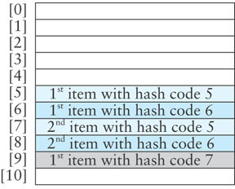
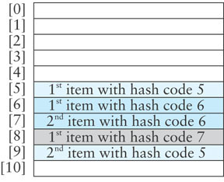
Reducing Collisions Using Quadratic Probing
Linear probing (left figure, below) tends to form clusters of keys in the hash table, causing longer search chains
Quadratic probing (right figure, below) can reduce the effect of clustering
Increments form a quadratic series (1 + 2² + 3² + ...)
probeNum++;
index = (startIndex + probeNum * probeNum) % table.length
If an item has a hash code of 5, successive values of index will be 6 (5+1), 9 (5+4), 14 (5+9), . . .

Slide 89
Problems with Quadratic Probing
The disadvantage of quadratic probing is that the next index calculation is time-consuming, involving multiplication, addition, and modulo division
A more efficient way to calculate the next index is:
k += 2;
index = (index + k) % table.size();

Slide 90
Problems with Quadratic Probing (cont.)
Examples:
If the initial value of k is -1, successive values of k will be 1, 3, 5, …
If the initial value of index is 5, successive value of index will be 6 (= 5 + 1), 9 (= 5 + 1 + 3), 14 (= 5 + 1 + 3 + 5), …
The proof of the equality of these two calculation methods is based on the mathematical series:
n² = 1 + 3 + 5 + ... + 2n - 1

Slide 91
Problems with Quadratic Probing (cont.)
A more serious problem is that not all table elements are examined when looking for an insertion index; this may mean that
an item can't be inserted even when the table is not full
the program will get stuck in an infinite loop searching for an empty slot
If the table size is a prime number and it is never more than half full, this won't happen
However, requiring a half empty table wastes a lot of memory

Slide 92
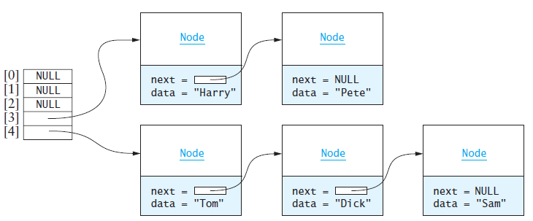
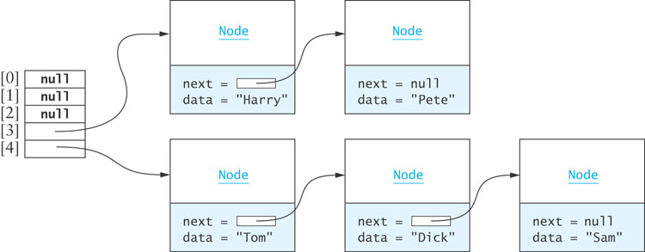
Chaining
Chaining is an alternative to open addressing
Each table element references a linked list that contains all of the items that hash to the same table index
The linked list often is called a bucket
The approach sometimes is called bucket hashing

Slide 93
Chaining (cont.)
Advantages relative to open addressing:
Only items that have the same value for their hash codes are examined when looking for an object
You can store more elements in the table than the number of table slots (indices)
Once you determine an item is not present, you can insert it at the beginning or end of the list
To remove an item, you simply delete it; you do not need to replace it with a dummy item or mark it as deleted

Slide 94
Performance of Hash Tables
Load factor is the number of filled cells divided by the table size
Load factor has the greatest effect on hash table performance
The lower the load factor, the better the performance as there is a smaller chance of collision when a table is sparsely populated
If there are no collisions, performance for search and retrieval is O(1) regardless of table size

Slide 95
Performance of Open Addressing versus Chaining

Slide 96
Performance of Open Addressing versus Chaining (cont.)
Using chaining, if an item is in the table, on average we must examine the table element corresponding to the item’s hash code and then half of the items in each list
c = 1 +
where L is the average number of items in a list (the number of items divided by the table size)

Slide 97
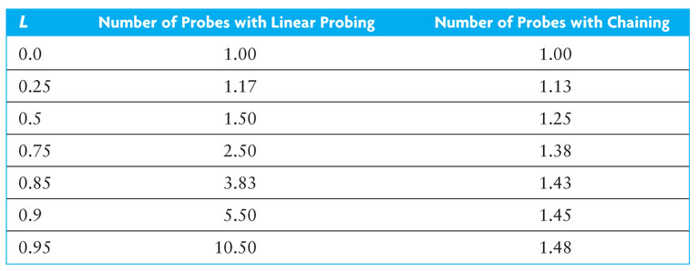
Performance of Open Addressing versus Chaining (cont.)

Slide 98
Performance of Hash Tables versus Sorted Arrays and Binary Search Trees
The number of comparisons required for a binary search of a sorted array is O(log n)
A sorted array of size 128 requires up to 7 probes (2⁷ is 128) which is more than for a hash table of any size that is 90% full
A binary search tree performs similarly
Insertion or removal
hash table | O(1) expected; worst case O(n)
unsorted array | O(n)
binary search tree | O(log n); worst case O(n)

Slide 99
Storage Requirements for Hash Tables, Sorted Arrays, and Trees
The performance of hashing is preferable to that of binary search of an array or a binary search tree, particularly if the load factor is less than 0.75
However, the lower the load factor, the more empty storage cells
there are no empty cells in a sorted array
A binary search tree requires three references per node (item, left subtree, right subtree), so more storage is required for a binary search tree than for a hash table with load factor 0.75

Slide 100
Storage Requirements for Open Addressing and Chaining
For open addressing, the number of references to items (key-value pairs) is n (the size of the table)
For chaining , the average number of nodes in a list is L (the load factor) and n is the number of table elements
Using the C++ list class, there will be two references in each node (next, previous)
Using our own single linked list, we can reduce the references to one by eliminating the previous-element reference
Therefore, storage for n + L references is needed

Slide 101
Storage Requirements for Open Addressing and Chaining (cont.)

Slide 102
Storage Requirements for Open Addressing and Chaining (cont.)
A hash table of size 20,000 provides storage space for 20,000 references to lists
There are 60,000 nodes in the table (one for each item)
Using a single-linked list, this requires storage for 60,000 pointers. This is the same as the storage needed for open addressing

Slide 103
Implementing the Hash Table
Section 9.4

Slide 104
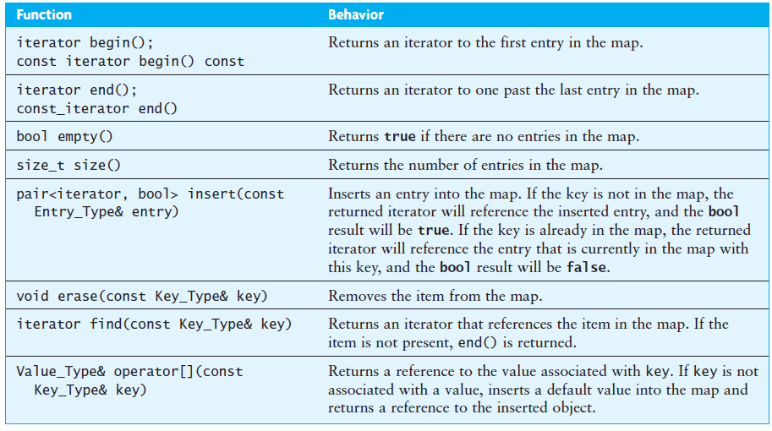
The KW::hash_map ADT

Slide 105
The Entry_Type
Type Entry_Type is defined as follows:
typedef std::pair<const Key_Type, Value_Type> Entry_Type;

Slide 106
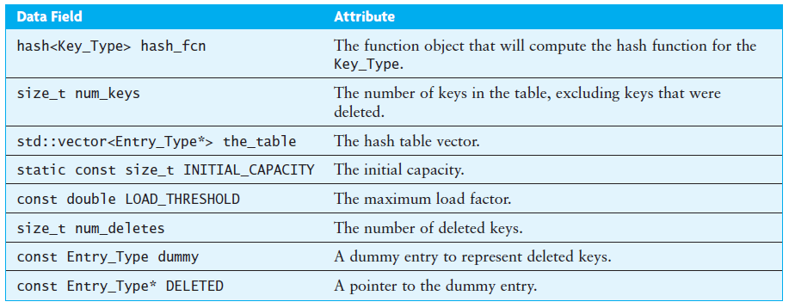
Data Fields Class hash_map as Implemented by Hash_Table_Open.h

Slide 107
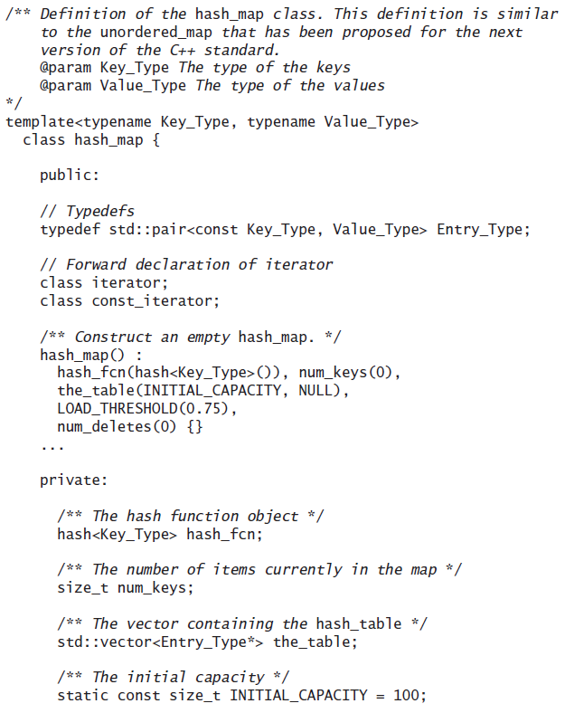
Class hash_map as Implemented by Hash_Table_Open.h

Slide 108
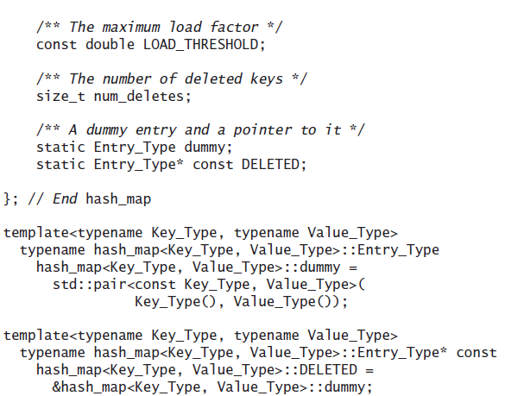
Class hash_map as Implemented by Hash_Table_Open.h

Slide 109
Class hash_map as Implemented by Hash_Table_Open.h (cont.)
Static data members must be initialized outside of the class declaration
For nontemplate classes, initialization statements appear in the .cpp file
For template classes, initialization statements must appear in the include file (.h) and must be qualified by a class name, including template parameters

Slide 110
The locate Function
Algorithm for hash_map::locate(const Key_Type& key)
1. Set index to hash_fcn(key) % the_table.size(),where hash_fcn is the hash function
2. while the_table[index] is not empty and the key is not at the_table[index]
3. Increment index modulo the_table.size()
4. Return the index.

Slide 111
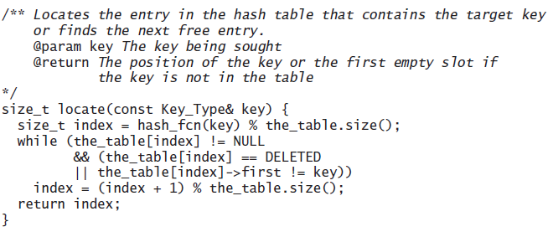
The locate Function (cont.)

Slide 112
The insert Function
Algorithm for hash_map::insert(const Entry_Type& entry)
Check for the need to rehash
Find the first table element that is empty or the table element that contains the key
if an empty element was found
Insert the new item and increment num_keys
Return make_pair(iterator to the inserted item, true)
else // key was found
Return make_pair(iterator to the found item, false)

Slide 113
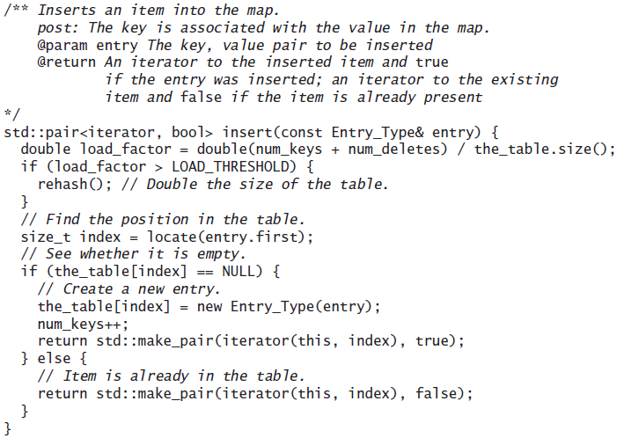
The insert Function (cont.)

Slide 114
The Subscript Operator (operator[])
Algorithm for the Subscript Operator (operator[])
Call insert to insert a new entry consisting of the key and a default Value_Type object
Use the iterator returned from the call to insert to return a reference to the value that corresponds to the key

Slide 115
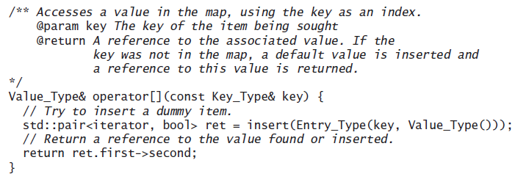
The Subscript Operator (operator[]) (cont.)

Slide 116
The erase Function
Algorithm for erase(const Key_Type& key)
Find the first table element that is empty or the table element that contains the key
if an empty element is found
Return
else
The key is found
Remove this table element by setting it to point to DELETED, increment num_deletes, and decrement num_keys

Slide 117
The rehash Function
Algorithm for rehash
Allocate a new hash table that is double the size
Reset the number of keys and number of deletions to 0
Reinsert each table entry that has not been deleted in the new hash table

Slide 118
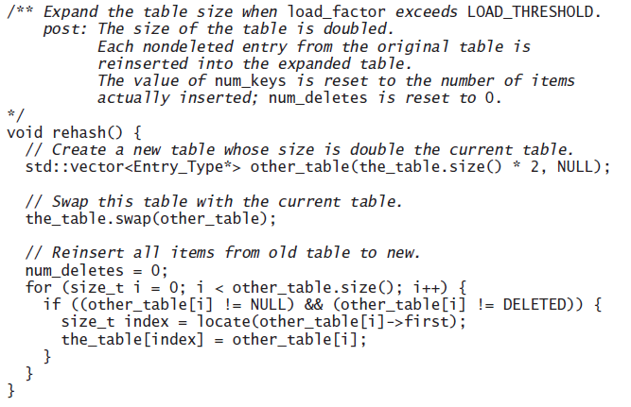
The rehash Function (cont.)

Slide 119
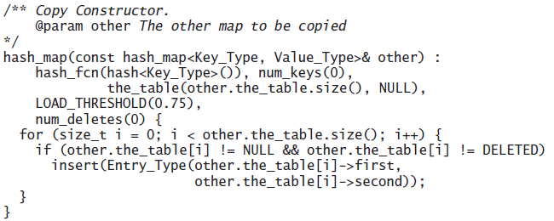
The Copy Constructor, Assignment Operator, and Destructor
Because the vector<Entry_Type*> table contains pointers to dynamically allocated Entry_Type objects, we need to implement the copy constructor and assignment operators so that they make copies of the objects pointed to when a hash_map is copied
We also need to delete these dynamically allocated objects when a hash_map is destroyed

Slide 120
Class hash_map as Implemented by Hash_Table_Chain.h

Slide 121
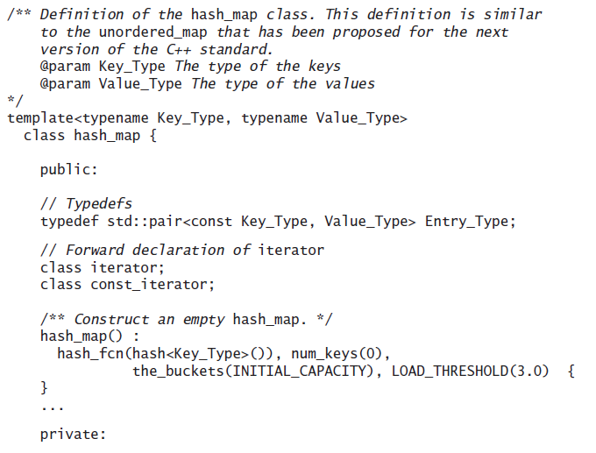
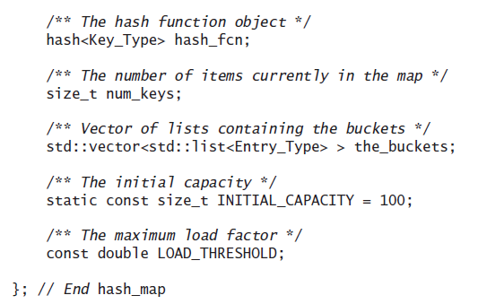
Class hash_map as Implemented by Hash_Table_Chain.h

Slide 122
The insert Function
Algorithm for insert(const Entry_Type& entry)
Check for need to rehash
Set index to hash_fcn(key) % the_buckets.size()
Search the list at the_buckets[index] to find the key
if not found
Append a new entry to the end of this list
Return make_pair(iterator to the inserted item, true)
else
Return make_pair(iterator to the found item, false)

Slide 123
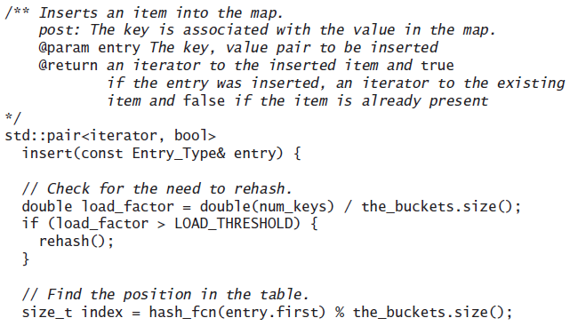
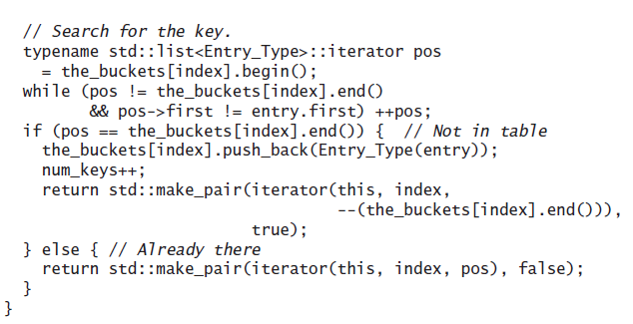
The insert Function (cont.)

Slide 124
The erase Function
Algorithm for hash_map:erase(const Key_Type& key)
Set index to hash_fcn(key) % the_buckets.size()
Search the list at table[index] to find the key
if the search is successful
Erase the entry with this key and decrement num_keys

Slide 125
Copy Constructor, Assignment, and Destructor
Because Hash_Table_Chain.h uses a std::vector<std::list<Entry_Type> > to hold the hash table
the default copy constructor and assignment operator will make a deep copy of the hash_map
the default destructor will delete any dynamically allocated objects

Slide 126
Testing the Hash Table Implementation
Write a method to
create a file of key-value pairs
read each key-value pair and insert it in the hash table
observe how the hash table is filled
Implementation
Write a to_string method that captures the index of each non-NULL table element and the contents of the table element
For open addressing, the contents consists of the string representation of the key-value pair
For chaining, an iterator can traverse the linked list at the table element and append each key-value pair to the result string

Slide 127
Testing the Hash Table Implementation (cont.)
Cases to examine:
Does the array index wrap around as it should?
Are collisions resolved correctly?
Are duplicate keys handled appropriately? Is the new value retrieved instead of the original value?
Are deleted keys retained in the table but no longer accessible via a operator[]?
Does rehashing occur when the load factor reaches 0.75 (3.0 for chaining)?
Step through the insert method to
observe how the table is probed
examine the search chain followed to access or retrieve a key

Slide 128
Testing the Hash Table Implementation (cont.)
Alternatively, insert randomly generated integers in the hash table to create a large table with little effort
for (int i = 0; i < SIZE; i++) {
int next_int = rand();
hash_table[next_int] = next_int;
}

Slide 129
Testing the Hash Table Implementation (cont.)
Insertion of randomly generated integers into a table allows testing of tables of very large sizes, but is less helpful for testing for collisions
After the table is complete, you can interactively enter items to retrieve, delete, and insert and verify that they are handled properly

Slide 130
Testing the Hash Table Implementation (cont.)
If you are using open addressing, you can add statements to count the number of items probed each time an insertion is made—these can be totaled and divided by the number of insertions to determine the average number of probes
If you are using chaining, you can also count the number of probes made and display the average
After all items are inserted, you can calculate the average length of each linked list and compare that with the number predicted by the formula discussed in Section 9.3

Slide 131
Implementation Considerations for the hash_map
Section 9.5

Slide 132
Defining the Hash Function Class
/** Hash Function Objects Template */
template<typename Key_Type>
struct hash {
size_t operator()(const Key_Type&);
};
No implementation is provided
Instead specializations are provided for built-in types and library-defined types such as string

Slide 133
Specialization for string

Slide 134
Specialization for int
Using an int value as a hash function does not tend to distribute the keys evenly
A better approach is to multiply the int value by a large (unsigned) prime number and take the modulo
// Specialization for int
template<>
struct hash<int> {
size_t operator()(int i) {
return size_t(4262999287U * i);
}
};

Slide 135
Specialization for Your Own Classes
To use objects of your own classes as keys in a hash_map, define the equality operator (==) and specialize the hash function class
The hash function is used to start the search, and the equality operator is used to finish it
The hash function must obey the following contract:
If obj1 == obj2 is true, then hash<type>()(obj1) == hash<type>()(obj2)
where obj1 and obj2 are objects of type type.
You should make sure that your function uses the same data field(s) as your equality operator

Slide 136
Specialization for Your Own Classes (cont.)
Class Person has data field IDNumber, which is used to determine whether two Person objects are equal. The equality operator returns true only if the objects’ IDNumber fields have the same contents
bool operator==(const Person& other) const {
return IDNumber == other.IDNumber;
}
To satisfy its contract, function hash<Person> also must be specialized as follows
template<>
struct hash<Person> {
size_t operator()(const Person& p) {
return hash<string>()(p.IDNumber);
}
};

Slide 137
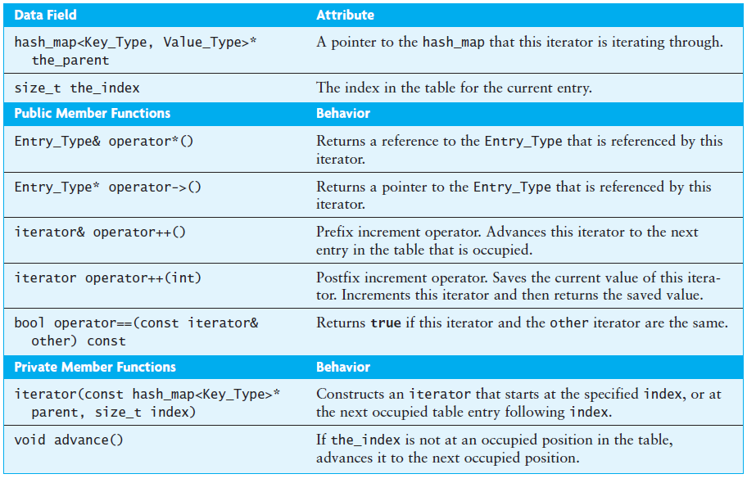
The hash_map::iterator and hash_map::const_iterator

Slide 138
The hash_map::iterator and hash_map::const_iterator (cont.)
The const_iterator must provide a public constructor that converts from an iterator to a const_iterator
The definition of this constructor is:
const_iterator(const typename hash_map<Key_Type,
Value_Type>::iterator& other)
: the_parent(other.the_parent), the_index(other.the_index) {}

Slide 139
The hash_map::iterator and hash_map::const_iterator (cont.)
The other constructors for iterator and const_iterator are private because we do not want the client programs to create arbitrary iterators
The only valid iterator objects are ones created by the member functions of the hash_map that owns the iterator
iterator and const_iterator classes must declare the hash_map as a friend
iterator must also declare the const_iterator as a friend for the conversion constructor just described

Slide 140
Additional Applications of Maps
Section 9.6

Slide 141
Implementing the Phone Directory Using a Map
Problem
Use a map to obtain a more efficient implementation (better than O(n)) of our Phone_Directory ADT (previously implemented as an array and later as a vector)

Slide 142
Implementing the Phone Directory Using a Map (cont.)
Analysis
A map will associate the name (the key) with a list of phone numbers (value)
Index | Value
Jane Smith | 215-555-1234
John Smith | 215-555-1234
Bill Jones | 508-555-6123

Slide 143
Implementing the Phone Directory Using a Map (cont.)
Analysis
We can implement the Phone_Directory ADT by using a map<string, string> object for the phone directory. The map<string, string> object would contain the key-value pairs
{ ("Jane Smith", "215-555-1234"), ("John Smith", "215-555-1234"), ("Bill Jones", "508-555-6123") }
Index | Value
Jane Smith | 215-555-1234
John Smith | 215-555-1234
Bill Jones | 508-555-6123

Slide 144
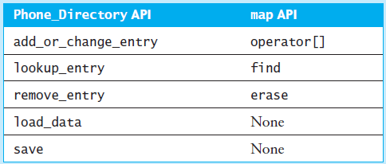
Implementing the Phone Directory Using a Map (cont.)
Design

Slide 145
Implementing the Phone Directory Using a Map (cont.)
Implementation – add or change entry
The following function is slightly inefficient since we do two searches of the map:
string Phone_Directory::add_or_change_entry(
const string& name, const string& number) {
string old_number = the_directory[name];
the_directory[name] = number;
// modified = true;
return old_number;
}

Slide 146
Implementing the Phone Directory Using a Map (cont.)
Implementation – add or change entry (revised)
The revised function:
string Phone_Directory::add_or_change_entry(
const string& name, const string& number) {
string old_number = "";
pair<iterator, bool> ret =
the_directory.insert(pair<string, string>(name, number));
if (!ret.second) { // Name already in the directory
old_number = ret.first->second;
ret.first->second = number;
}
// modified = true;
return old_number;
}

Slide 147
Implementing the Phone Directory Using a Map (cont.)
Implementation – look up an entry
/** Look up an entry.
@param name The name of the person
@return The number. If not in the directory, an empty string
*/
string Phone_Directory::lookup_entry(const string& name) const {
const_iterator itr = the_directory.find(name);
if (itr != the_directory.end())
return itr->second;
else
return "";
}

Slide 148
Implementing the Phone Directory Using a Map (cont.)
Implementation - remove
string Phone_Directory::remove_entry(const string& name) {
string old_number = the_directory[name];
the_directory.erase(name);
// modified = old_number != string();
return old_number;
}

Slide 149
Implementing the Phone Directory Using a Map (cont.)
Implementation – load data
The load_data function reads the entries from a data file and stores them in a map
We write the loop that does the read and store operations. It uses the subscript operator to add an entry with the given name and number
while (getline(in, name)) {
if (getline(in, number)) {
the_directory[name] = number;
}
}

Slide 150
Implementing the Phone Directory Using a Map (cont.)
Implementation – saving
To save the directory, we need to extract each name-number pair sequentially from the map and write them out. We can use a for loop and an iterator:
for (iterator itr = the_directory.begin();
itr != the_directory.end(); ++ itr) {
out << itr->first << "\n";
out << itr->second << "\n";
}

Slide 151
Implementing the Phone Directory Using a Map (cont.)
Testing
To test this code, modify the PD_Application.cpp file to include Map_Based_PD.h and compile and link this modified source file with the Map_Based_PD.cpp
The rest of the main function used to test the application will be the same

Slide 152
Huffman Coding
Problem
Build an array of (weight, symbol) pairs, where weight is the frequency of occurrence of each symbol for any data file
Encode each symbol in the input file by writing the corresponding bit string for that symbol to the output file

Slide 153
Huffman Coding (cont.)
Analysis
For each task in the problem, we need to look up a symbol in a table
Using a map ensures that the lookup is expected O(1)

Slide 154
Huffman Coding (cont.)
Analysis
For the frequency table, we need to read a file and count the number of occurrences of each symbol in the file
The symbol will be the key, and the value will be the count of its occurrences
As each symbol is read, we retrieve its map entry and increment the corresponding count
If the symbol is not yet in the frequency table, the map subscript operator will insert a zero the first time we reference it

Slide 155
Huffman Coding (cont.)
Analysis
Once we have the frequency table, we can construct the Huffman tree using a priority queue as explained in Section 8.6
Then we build a code table that stores the bit string code associated with each symbol to facilitate encoding the data file
Storing the code table in a map<char, Bit_String> object makes the encoding process more efficient, because we can look up the symbol and retrieve its bit string code (O(1) process)
To build the code table, we do a preorder traversal of the Huffman tree

Slide 156
Huffman Coding (cont.)
Design
Algorithm for build_frequency_table
while there are more characters in the input file
Read a character
Increment the entry in the map associated with this character
for each entry in the map
Store its data as a weight-symbol pair in the vector<Huff_Data>
Return the vector<Huff_Data>

Slide 157
Huffman Coding (cont.)
Design
Algorithm for Function build_code
Get the data at the current root
if reached a leaf node
Insert the symbol and bit string code so far as a new code table entry
else
Append a 0 to the bit string code so far
Apply the function recursively to the left subtree
Append a 1 to the bit string code
Apply the function recursively to the right subtree

Slide 158
Huffman Coding (cont.)
Design
Algorithm for Function encode
while there are more characters in the input file
Read a character and get its corresponding bit string code
Write its bit string to the output file

Slide 159
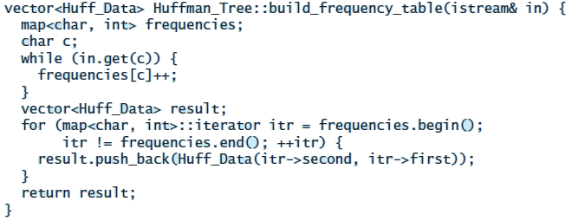
Huffman Coding (cont.)
Implementation

Slide 160
Huffman Coding (cont.)
Implementation (cont.)
/** Starter function to build the code table.
post: The table is built
*/
void build_code() {
code_map.clear();
build_code(huff_tree, Bit_String());

Slide 161
Huffman Coding (cont.)
Implementation (cont.)
/** Recursive function to perform depth-first traveral
of the Huffman tree and build the code table.
@param tree The current tree root
@param code The code string so far
*/
void Huffmann_Tree::build_code (const Binary_Tree<Huff_Data>& tree,
const Bit_string& code) {
if (tree.is_leaf()) {
Huff_Data datum = tree.get_data();
code_map[datum.symbol] = code;
} else {
// Append 0 to code so far and traverse left
Bit_String left_code(code);
left_code_append(false);
build_code(tree.get_left_subtree, left_code);
// Append 1 to code so far and traverse right
Bit_String right_code(code);
right_code_append(false);
build_code(tree.get_right_subtree, right_code);

Slide 162
Huffman Coding (cont.)
Implementation (cont.)
/** The map to store the code table */
Map<char, Bit_String> code_map;
/**Encodes the data by writing it in compressed bit string form.
@param in The input stream
@param out The output stream
*/
void Huffmann_Tree::encode (std::istream& in, std::ostream& out)
Bit_String result;
char next_char;
while (in.get(next_char)){
result += code_map[next_char];
}
result.write(out)
}

Slide 163
Huffman Coding (cont.)
Testing
Download class Bit_String and write a main method that calls the methods in the proper sequence
For interim testing, read a data file and display the frequency table to verify its correctness
Use the string class instead of Bit_String in functions build_code and encode to build a code of characters ('0' or '1') instead of bits; verify its correctness

